Slide 1

Recurrent Neural Networks –RNNs (Sequence Modelling)
Adv. Topics in Generative AI
Dr. Muhammad Nouman Noor
Department of AI & DS

Slide 2
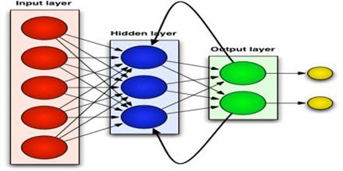
Contents
Sequence Models
ANNs vs. RNNs
Vanilla RNNs
Vanishing and Exploding Gradients

Slide 3
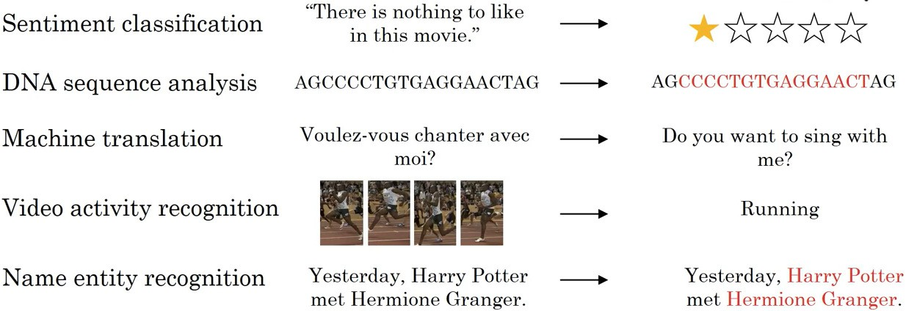
Sequence Models
Both input and output or one of these is a sequence
Slide Credit: Andrew Ng

Slide 4
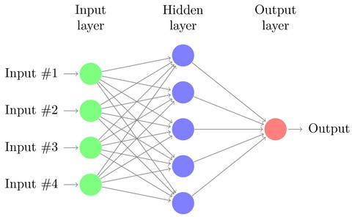
Artificial Neural Networks

Slide 5
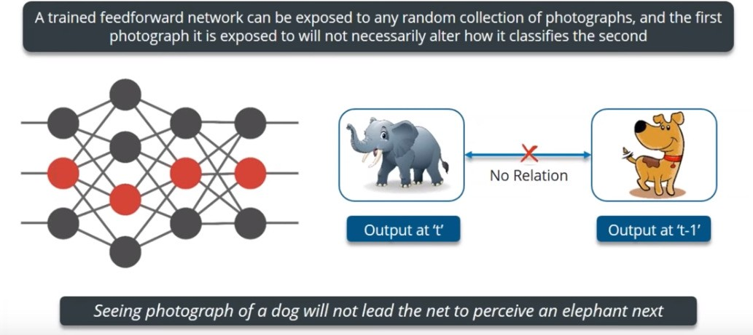
Artificial Neural Networks
Outputs are not dependent

Slide 6
Dependencies in Biological Neurons
Humans don’t start their thinking from scratch every second.
As we read this text, we understand each word based on the understanding of previous words.
We don’t throw everything away and start thinking from scratch again.
Our thoughts have persistence.

Slide 7
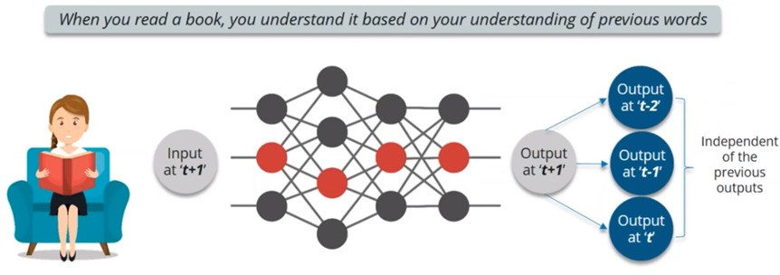
Book Reading - ANN
Predicting the next word?

Slide 8
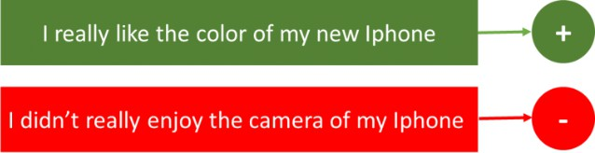
RNNs - Applications
Sentiment Classification
Input: Sequence of words (varying length)
Output: Class Label

Slide 9
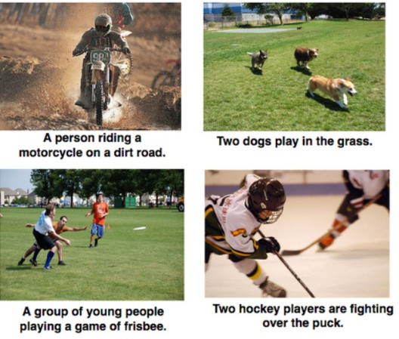
RNNs - Applications
Image Captioning
Input: Image
Output: Textual description (varying length)

Slide 10

RNNs - Applications
Language Translation
Input: Sequence of words
Output: Sequence of words
Lengths of input and output may vary

Slide 11
Why not ANNs?
ANNs can’t deal with sequential or temporal data
ANNs lack memory
ANNs have a fixed architecture
RNNs are more “biologically realistic” because of the recurrent connectivity found in the visual cortex of the brain

Slide 12
Why not ANNs?
Image Captioning: Output is a sequence of words of varying length
Sentiment Classification: Input is a sequence of words, if fed one by one, output is only dependent on current input, no relation with previous words

Slide 13


Building the Idea – A hypothetical case study
Example by Luis Serrano, Udacity

Slide 14






Case Study: Chef – Fond of Patterns
Cooks three types of dishes
Apple Pie
Burger
Chicken
Cooks according to weather
When it is sunny – Makes an Apple Pie
When it is rainy – Makes a Burger

Slide 15
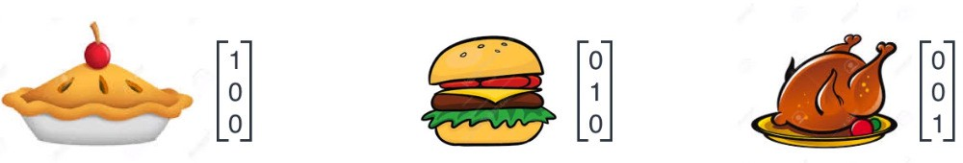
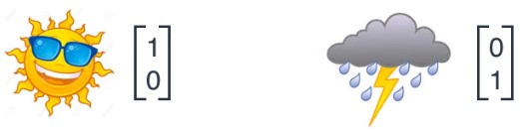


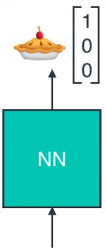
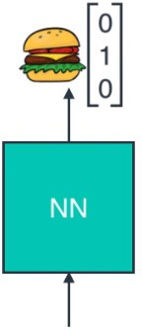
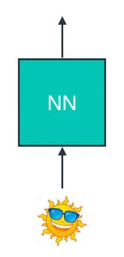
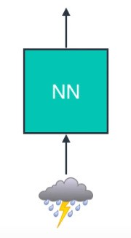

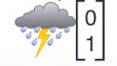
Case Study
Model the situation using ANN
Represent objects using vectors

Slide 16
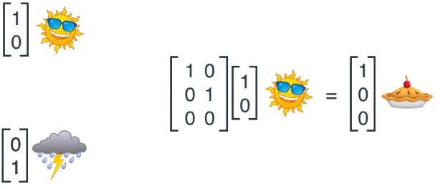
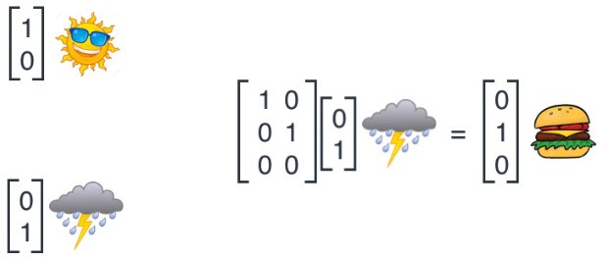
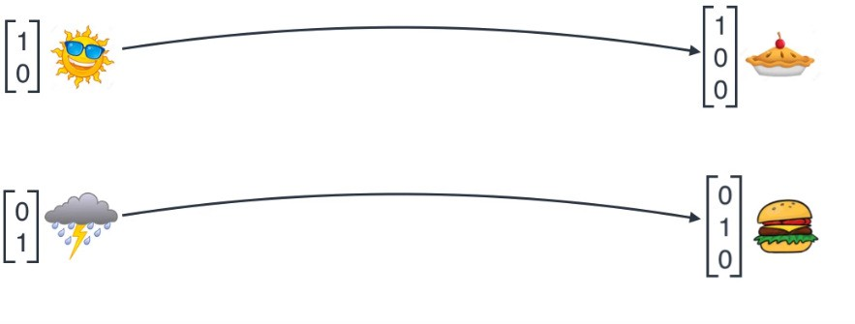
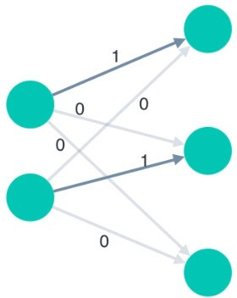
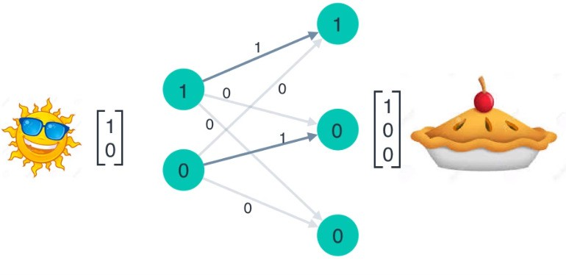
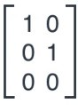
Neural Network: Matrix Multiplication
Multiply with vector corresponding to sunny – Apple Pie
Multiply with vector corresponding to sunny – Apple Pie
ANN – Mapping of weather (input) to food (output) vectors
Weight matrix as connections
ANN – Mapping weather to food

Slide 17

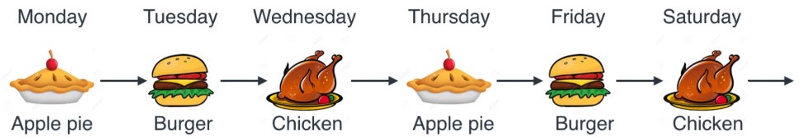
Case Study
Cooking is not based on weather
Cooks in a sequence
Cannot model it with the traditional (feed forward) neural network
Recurrent Neural Network

Slide 18
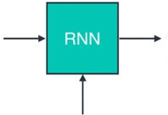


Recurrent Neural Network
No input for weather (Bottom arrow not coming from anywhere in this example)
Output goes back as input

Slide 19
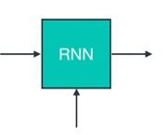


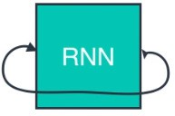

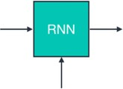
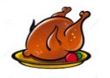
Recurrent Neural Network
Output at time step t-1 is input at time step t

Slide 20
Recurrent Neural Network
Absent for few days – Still predict the next dish by back tracking…

Slide 21
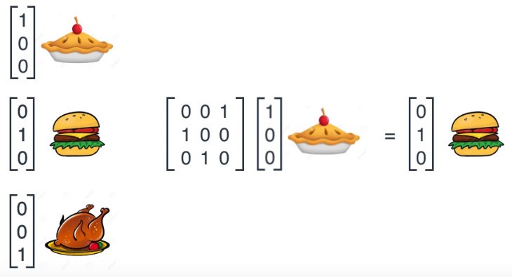
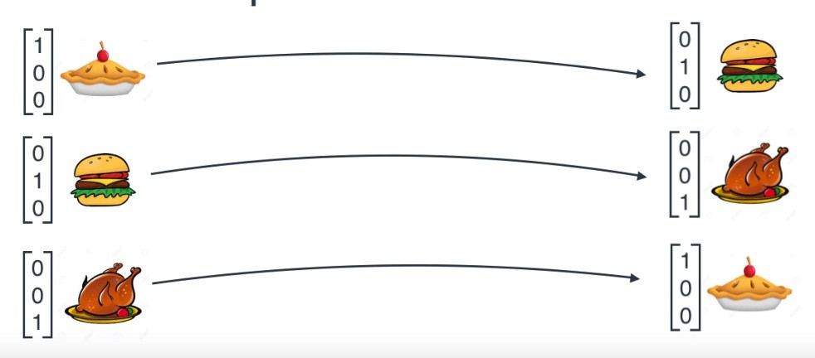
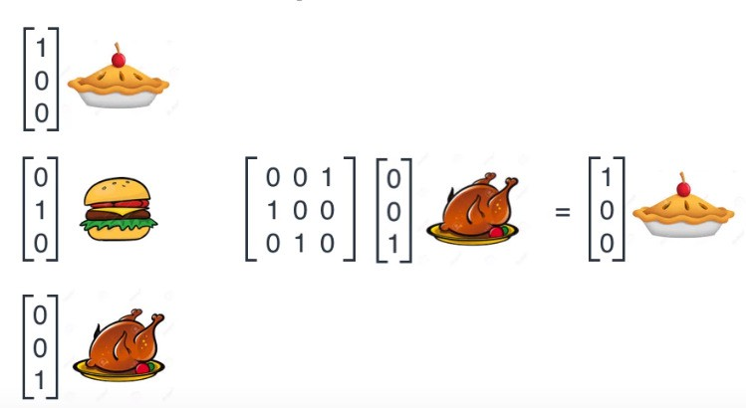
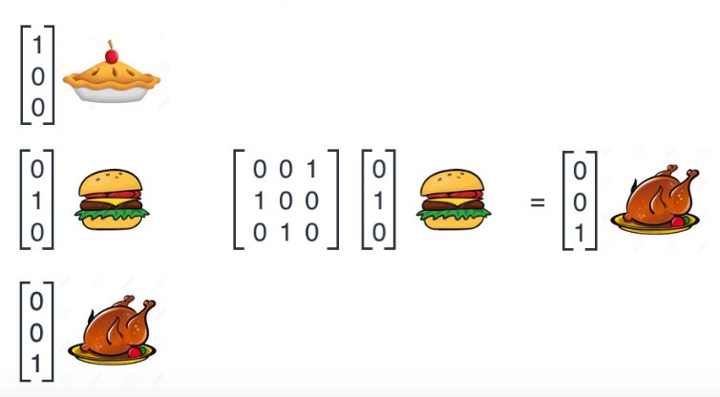
RNNs as vector operations
Mapping of food on day ‘t-1’ to day ‘t’

Slide 22
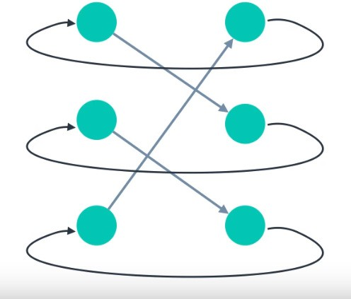
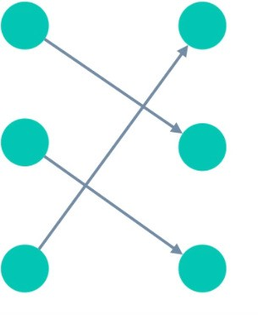
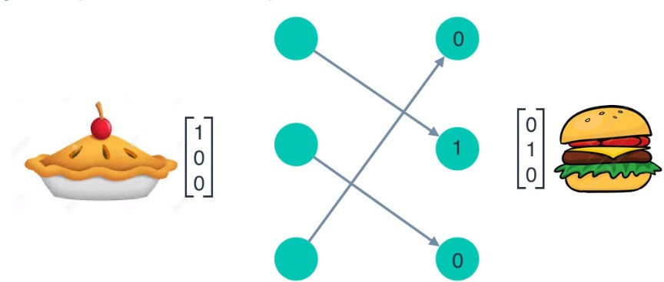
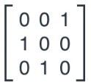
RNNs as vector operations
Matrix as ANN connections
Output comes back as input – Recurrent path

Slide 23


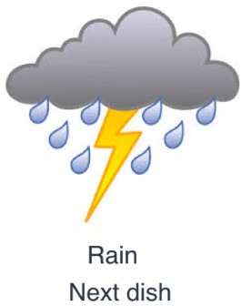
RNNs
The chef cooks in sequence but takes into account the weather
Sunny – Same dish as yesterday
Rain – Next dish on the list

Slide 24
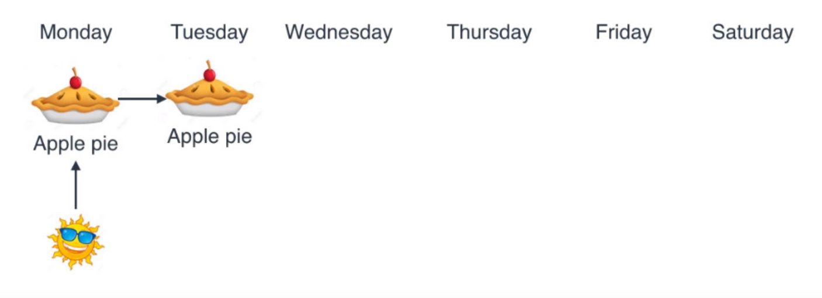
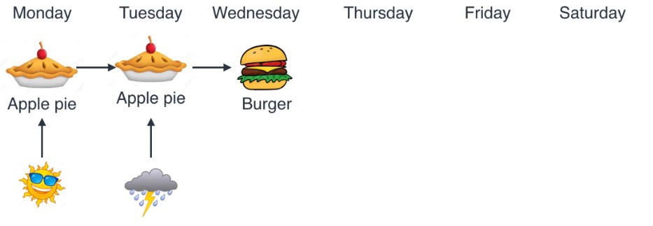
RNNs

Slide 25
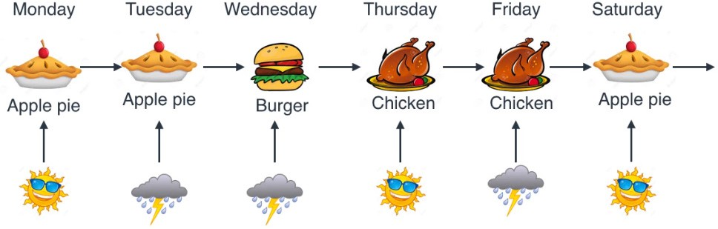
RNNs

Slide 26
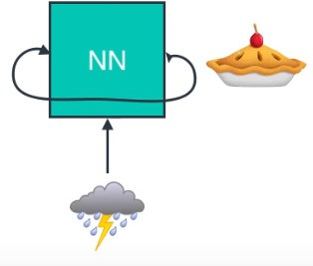
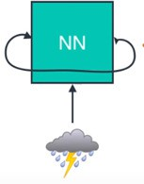


RNNs
Weather coming in as input
Food – Output that is fed back
Day t-1
Day t

Slide 27
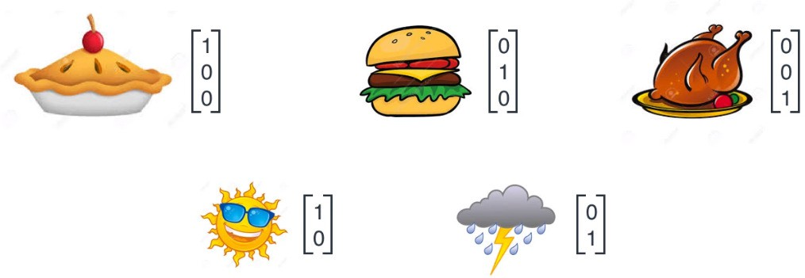
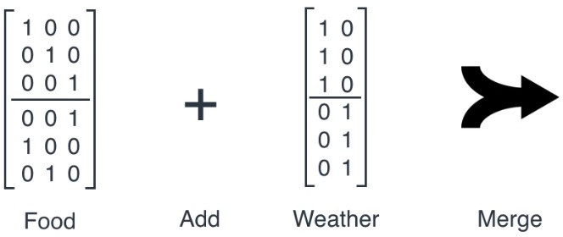
RNNs
Vector Representation

Slide 28
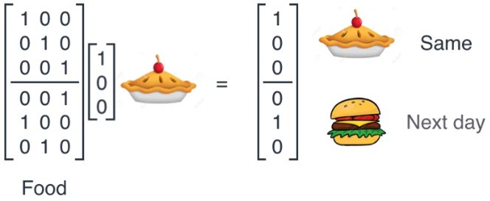
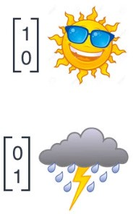
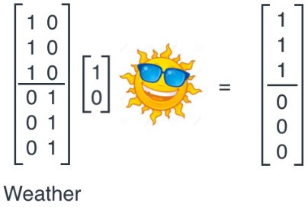
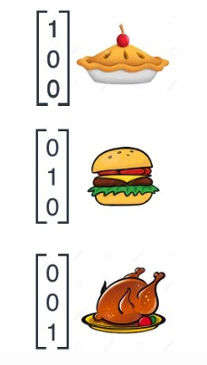
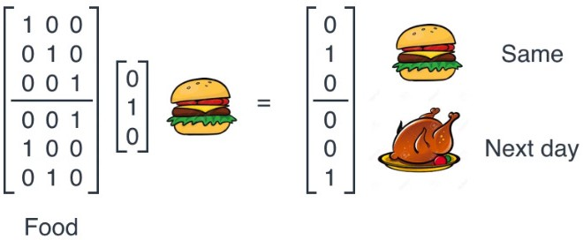
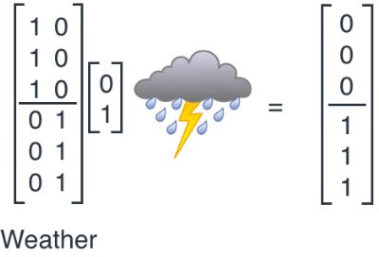
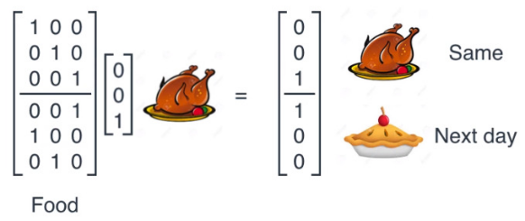
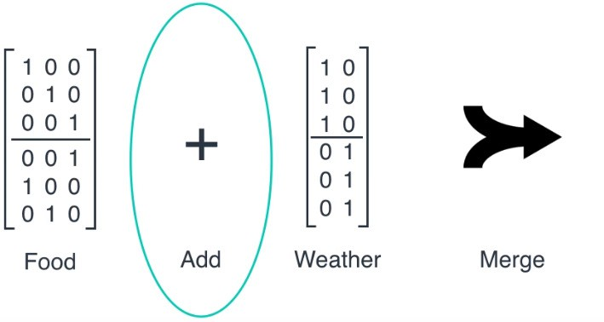
RNNs

Slide 29



RNNs
Yesterday: Apple Pie; Weather: Rainy
Scenario: Apple pie was cooked and it is raining, predict the dish for tomorrow

Slide 30

RNNs

Slide 31




RNNs

Slide 32


RNNs

Slide 33


RNNs - Training
Start with Random weights
Gradient Descente
Back Propagation in Time (BPT)
Coming up…

Slide 34


Slide 35







RNN - Mappings
ANN - Each neuron contains a single scalar value. Thus, each layer can be considered a vector.
An entire ANN layer is encapsulated into one neuron
Each neuron (inputs, hidden(s), and outputs) contains a vector of information.

Slide 36

RNN - Mappings
One to many: Image Captioning
It may seem that we have seven neurons
We still have three: one input neuron, one hidden neuron, and one output neuron.
The difference is that these neurons now experience multiple “time steps” where they take on different values, which are, again, vectors.

Slide 37




RNN - Mappings
Many-to-one: Sentiment Analysis
Input is in the form of a sequence, and so the hidden states are functionally dependent on both the input at that time step and the previous hidden state.

Slide 38












RNN - Mappings
Many-to-many: Language Translation
Can have multiple hidden layers or time steps

Slide 39

RNN Mappings: Graphical Summary
Credits: S. Amidi & A. Amidi

Slide 40


RNN Mappings: Graphical Summary
Credits: S. Amidi & A. Amidi

Slide 41


Example
Name Entity Recognition – Where are the people in a given text?
x: Geoffrey Hinton and his team introduced the capsule networks
_{x}<1> _{x}<2>
1 1
_{Y}<1> _{Y}<2>
…. … x^{<t>} ……. x^{<9>}
0 0 0 0 0 0 0
Y:
…. … …….
_{Y}<t> _{Y}<9>
Length of input sequence T_{x} = 9
Length of output sequence T_{y} = 9

Slide 42
Example
Notation: Element t in the sequence of training example i :
_{x}(i)<t>
Different training examples can have different legnhths
Length of training example i: T_{x}^{(i)}
For outputs:
_{y}(i)<t> _{and Ty}(i)
Representing individual words
Identify the vocabulary or dictionary
Vocabulary: All possible words in the data under study

Slide 43
Example
Assume a dictionary of 10,000 words
Use one-hot-vectors to represent words
For unknown words, use the token <UKN> add a row to dictionary
0
…1
… 301
…
… 6579
…
… 10000
a a…li
… bag
…
… harry
…
… zoo
0 …0 … |  | 0 …0 …
1 |  | 0
… |  | …
… |  | …
0 |  | 1
… |  | …
… |  | …
0 |  | 0
bag
harry

Slide 44

Example: Standard ANN
Problems:
Input, output lengths can be different in different examples – (Padding?)
No sharing of features learned across different positions of text

Slide 45


Recurrent Neural Network
Reading a sentence from left to right
Read the first word x^{<1>}; feed it into a neural network (hidden) layer; try to predict the output (Name of person or not)
When the network reads the next word x^{<2>}; instead of predicting the output y^^{<2>} only from the current input it also gets some information from what it had computed at time step 1.
The activation value from time step 1 is passed to time step 2

Slide 46


Recurrent Neural Network
Add the next time step, the network received the third input x^{<3>} and tries to predict the output y^^{<3>} and so on……
Tx = Ty in this example

Slide 47


Recurrent Neural Network
At each time step, the neural network passes its activation to the next time step
For consistency a^{<0>} is also introduced (mostly all zeros)
_{y^}<t>
_{x}<t>

Slide 48
Recurrent Neural Network
RNNs scan the data from left to right
Parameters used at each time step are shared
If W_{ax} is the parameter matrix from input to hidden layer, all time steps will share the same matrix
^{W}ax
^{W}ax
^{W}ax
^{W}ax

Slide 49
Recurrent Neural Network
In making predictions for x^{<3>} the network not only gets information from x^{<2>} but also from x^{<1>} and so on…
Weakness: The RNN employs only past information to predict the output – Future information can also be useful

Slide 50
Recurrent Neural Network
Given only the past context, it may not be possible to correctly predict the label of a word
He told us that Paris …. He told us that Paris …
He said “Teddy …. He said “Teddy ….

Slide 51
Recurrent Neural Network
Given only the past context, it may not be possible to correctly predict the label of a word
He told us that Paris Hilton is the great-granddaughter of Conrad Hilton He told us that Paris is likely to receive more snow this winter.
He said “Teddy Roosevelt was a great President” He said “Teddy bears are on sale!”
The future information can be useful

Slide 52
Recurrent Neural Network
In the first example “Teddy” refers to a name in the second it does not.
The word “president” is a useful clue in predicting “Teddy” as a name
Given only the first three words, it is not possible to predict the label for “Teddy”
RNNs use information from elements earlier in the sequence but not from those later in the sequence
– Solution: Bidirectional RNN (B-RNNs)

Slide 53
Forward Propagation
_{a}<0> ₌ ₀
a^{<1>} = g(W_{aa} . a^{<0>} + W_{ax} . x^{<1>} + b_{a})
y^^{<1>} = g(W_{ya} . a^{<1>} + b_{y})
Typically for hidden layers, the activation function is tanh while for output it is
sigmoid (2 class – Name entity for example) or softmax (multiclass)

Slide 54
RNN – Simplified Notation
a^{<t>} = g(W_{a} . [a^{<t–1>}, x^{<t>}] + b_{a})
y^^{<t>} = g(W_{y} . a^{<t>} + b_{y})

Slide 55


RNN – Summary
For each timestep t, the activation a^{<t>} and the output y^{<t>} are expressed as follows:
W_{ax},W_{aa},W_{ya},b_{a},b_{y} are coefficients that are shared temporally and g₁,g₂ are activation functions.

Slide 56



RNN – Formal Definition
RNNs take input, process that input through multiple time steps and hidden layers, and produce output.
The arrow both leaving and entering the RNN conveys that an RNN hidden state is functionally dependent on the hidden state at the preceding time step.

Slide 57
RNN – Formal Definition
Generalized RNN: Sequential input, sequential output, multiple time steps, and multiple hidden layers.
The formula we derive for this RNN should generalize for all others.
Functional dependencies for a given hidden state:
An input
Hidden state at the previous time step, same layer
Hidden state at the current time step, previous layer

Slide 58

RNN – Common Activation Functions

Slide 59




RNN – Mathematical Formulation
Defining the activation function
Output Mapping

Slide 60

RNN – Mathematical Formulation
Activation Function - tanh

Slide 61


RNN – Mathematical Formulation
Vector Transformations without tanh
Vector Transformations with tanh

Slide 62
Example – Character Learning Model
A character level RNN where we have a word “Hello”
We provide the first 4 letters i.e. h,e,l,l and ask the network to predict the last letter i.e. ’o’.
Vocabulary of the task is just 4 letters {h,e,l,o}.
In real case scenarios involving natural language processing, the vocabularies include the words in entire wikipedia database, or all the words in a language.

Slide 63


Example – Character Learning Model
One hot encoding of vocabulary

Slide 64









Example – Character Learning Model
The RNN is saying: given “h”, “e” is most likely to be the next character. Given “he”, “l” is the next likely character. With “hel”, “l” should be next, and with “hell”, the final character should be “o”.

Slide 65

Example – Character Learning Model
The blue RNN block, applies a recurrence formula to the input vector and also its previous state.
In this case, the letter “h” has nothing preceding it.
Let’s take the letter “e”.
h_{t} is the new state, h_{t-1} is the previous state while
x_{t} is the current input.

Slide 66
Example – Character Learning Model
Equation for state at time t:
h_{t} = tanh(W_{hh}h_{t1} + W_{xh}x_{t} + b_{h})
Activation function is tanh, the weight at the recurrent neuron is W_{hh} and the weight at the input neuron is W_{xh}
Once the current state is calculated we can calculate the output state as:
y_{t} = g(W_{hy}h_{t} + b_{y})

Slide 67
Example – Character Learning Model
A single time step of the input is supplied to the network i.e. x_{t}
is supplied to the network
We then calculate its current state using a combination of the current input and the previous state i.e. we calculate h_{t}
The current h_{t} becomes h_{t-1} for the next time step
We can go as many time steps as the problem demands and combine the information from all the previous states
Once all the time steps are completed the final current state is used to calculate the output y_{t}
The output is then compared to the actual output and the error is generated
The error is then backpropagated to the network to update the weights and the network is trained

Slide 68









Example – Character Learning Model

Slide 69

Example – Character Learning Model
Unfolding the RNN

Slide 70












Example – Character Learning Model
h_{t} = tanh(W_{hh}h_{t1} + W_{xh}x_{t} + b_{h})
Step 1: For the letter “h”, for the hidden state we need W_{xh}*X_{t}
For the letter “h”, there is no previous state; Hence h_{t-1}=[0, 0, 0]

Slide 71







Example – Character Learning Model
h_{t} = tanh(W_{hh}h_{t1} + W_{xh}x_{t} + b_{h})
Step 2: Compute the state h_{t} as a function of X_{t} and h_{t-1}
^{W}hh^{h}t-1
Bias
^{W}xh^{x}t

Slide 72



Example – Character Learning Model
h_{t} = tanh(W_{hh}h_{t1} + W_{xh}x_{t} + b_{h})
Step 2: Compute the state h_{t} as a function of X_{t} and h_{t-1}

Slide 73









Example – Character Learning Model
Step 3: The next character “e” is supplied to the network
h_{t} = tanh(W_{hh}h_{t1} + W_{xh}x_{t} + b_{h})

Slide 74








Example – Character Learning Model
Step 3: The next character “e” is supplied to the network
h_{t} = tanh(W_{hh}h_{t1} + W_{xh}x_{t} + b_{h})

Slide 75






Example – Character Learning Model
Step 3: The next character “e” is supplied to the network
h_{t} = tanh(W_{hh}h_{t1} + W_{xh}x_{t} + b_{h})

Slide 76





Example – Character Learning Model
Step 3: The next character “e” is supplied to the network
h_{t} = tanh(W_{hh}h_{t1} + W_{xh}x_{t} + b_{h})

Slide 77








Example – Character Learning Model
Step 5: Supply the next letter and the process continues

Slide 78




Example – Character Learning Model
Output: At each state, the recurrent neural network would produce the output as well.
The output Y_{t} for letter “e” is calculated.
y_{t} = g(W_{hy}h_{t} + b_{y})

Slide 79






Example – Character Learning Model
Output: At each state, the recurrent neural network would produce the output as well.
The output Y_{t} for letter “e” is calculated.
y_{t} = g(W_{hy}h_{t} + b_{y})
Y_{t}
Class-wise Probabilities:

Slide 80



Example – Character Learning Model
Output: At each state, the recurrent neural network would produce the output as well.
The output Y_{t} for letter “e” is calculated.
h_{t} = tanh(W_{hh}h_{t1} + W_{xh}x_{t} + b_{h})
y_{t} = g(W_{hy}h_{t} + b_{y})
Y_{t}
If we convert these probabilities to understand the prediction, we see that the model says that the letter after “e” should be h, since the highest probability is for the letter “h”.
Note: We have hardly trained the network. We have just shown it two letters. So it pretty much hasn’t learnt anything yet.

Slide 81



RNN – Different Representations

Slide 82











RNN – Different Representations

Slide 83






Problems with RNNs
Some times we need only recent context
Language model – Trying to predict the next word
The clouds are in the
No further context required (“Sky” is next word)
Gap between relevant information and the place it is needed is small – RNNs can learn to predict – Short Term Dependency

Slide 84







Problems with RNNs
Some times we need longer context
I grew up in France……………… I speak fluent
.
Recent context tells: Name of language.
Which language? – Need context of France
Gap between relevant info and point it is need is very large – Long Term Dependency

Slide 85

Problems with RNNs
RNNs don’t just need memory; they need long term memory.
Radovan Karadžić and the first president of the Republika Srpska was declared a war criminal ……………..and should be sent to
If the RNN wasn’t able to look back much (i.e. before “should”), then many different options could arise:

Slide 86
Problems with RNNs
The word “sent” would indicate to the RNN that a location needs to be outputted. However, if the RNN was able to retain information from all the way back, such as the word “criminal”, then it would be much more confident that:
Radovan Karadžić and the first president of the Republika Srpska was declared a war criminal ……………..and should be sent to jail.
The probability of outputting “jail” drastically increases when it sees the word “criminal” is present. That’s why context matters, be it predictive typing, image captioning, machine translation, etc.

Slide 87

Problems with RNNs
The model is trained to generate a sentence.
Example: 'Those cats caught a fish,....., they were very happy.'
The RNN needs to remember the word 'cats' as a plural to generate the word 'they' in the following sentence.

Slide 88

Problems with RNNs
Basic RNN model has local influences - the output is mostly affected by the value close to it.
The output y^{<3>}is mainly influenced by values close to y^{<3>}

Slide 89

Problems with RNNs
the output y^{<Ty>} cannot be influenced by the early inputs in the sequences (x ^{<1>}, x^{<2>}, x^{<3>}).
It has hard for the error to back propagate to the beginning of the sequence.

Slide 90
Problems with RNNs
During back propagation, RNNs suffer from problem of vanishing (exploding) gradient when learning long term dependencies
Gradients are values used to update a neural networks weights.
The vanishing gradient problem is when the gradient shrinks as it back propagates through time.
If a gradient value becomes extremely small, it doesn’t contribute too much learning.

Slide 91

Vanishing/Exploding Gradient

Slide 92

Vanishing/Exploding Gradient

Slide 93



Vanishing Gradient

Slide 94



Exploding Gradient

Slide 95

Solution
Long Short Term Memory Networks (LSTMs)

Slide 96

Sentiment Classification with RNNs

Slide 97

Sentiment Classification with RNNs
x y
Credits: Andrew Ng

Slide 98


Sentiment Classification with a Simple Model
Avg
y^
300 Dim
Softmax
One-hot vectors
Embedding Matrix
Embedding Vectors (300 Dim)

Slide 99





Sentiment Classification with a Simple Model
Computing average: Lot of representation of the vector corresponding to “good”
Avg
y^
300 Dim
Softmax
One-hot vectors
Embedding Matrix
Embedding Vectors (300 Dim)

Slide 100


Sentiment Classification with RNNs
Credits: Andrew Ng

Slide 101


Implementing RNNs
IMDB Movie dataset
50K reviews – Positive/Negative

Slide 102

Implementing RNNs
Reviews have been preprocessed, and each review is encoded as a sequence of word indexes (integers).
For convenience, words are indexed by overall frequency in the dataset, so that for instance the integer "3" encodes the 3rd most frequent word in the data.
Example: A review of length 500 using 100 most frequent words

Slide 103


Implementing RNNs
Load Data
Pick 100 most frequent words
Limit the length of each review to 500 words
Pad Sequences (to ensure all have same length)

Slide 104


Simple RNN
Design the RNN
Compile and Train

Slide 105

Simple RNN
Number of Parameters

Slide 106

Simple RNN
Visualize the network
– pip install graphviz

Slide 107

Deep RNN

Slide 108


Deep RNN
Add more recurrent layers

Slide 109

Bidirectional RNN

Slide 110

Bidirectional RNN
Bidirectional recurrent neural networks(RNN) are really just putting two independent RNNs together.
The input sequence is fed in normal time order for one network, and in reverse time order for another.
The outputs of the two networks are usually concatenated at each time step, though there are other options, e.g. summation

Slide 111


Bidirectional RNN
Wrap the RNN Layer in a Bidirectional Layer
Deep Bidirectional RNN

Slide 112

1D CNN
1D CNN for sentiment classification

